Slide 1
IKAS--晶合MVA分析汇报
—— Case2

Slide 2
01
IKAS—晶合MVA Case2

Slide 3
Case2 MVA 分析目标
背景
DSA02 O-ring damage induce WA12/15 defect NG@2023/6/1~2023/7/10
目标
通过Good/Bad Wafer进行对比找出异常原因
锁定异常发生时间段
锁定异常机台及chamber
对目标站点及机台进行FDC分析，确认异常sensor权重
绘制UVA and trace chart直观展示
整理报告，输出结果并给出建议

Slide 4
Case2 MVA 分析结论
结论
共性站点2F.CDS10, 机台为DSA02_B
异常sensor权重占比最高的是CUSTOMEQUATION#CUSTOMEQUATION; WAFER_TEMPERATURE; RFREFLECTEDPOWER
建议
查看history，FDC异常没有触发hold lot，建议增加异常sensor的FDC 卡控规则

Slide 5
Case2 共性机台分析 ETK72 UVA FDC权重分析
共性机台
OPER_NO | EQP_NAME | TOOL_NAME | bad_count | bad_ratio | total_bad_count
2F.CDS10 | DSA02 | DSA02_B | 188 | 0.789915966 | 238
1M.ECM10 | CMA04 | CMA04_P3 | 187 | 0.785714286 | 238
1M.ECM10 | CMA04 | CMA04_P2 | 187 | 0.785714286 | 238
1M.ECM10 | CMA04 | CMA04_P1 | 187 | 0.785714286 | 238
1M.ECM10 | CMA04 | CMA04_Mega | 187 | 0.785714286 | 238
1M.ECM10 | CMA04 | CMA04_Dryer | 187 | 0.785714286 | 238
1M.ECM10 | CMA04 | CMA04_Brush2 | 187 | 0.785714286 | 238
1M.ECM10 | CMA04 | CMA04_Brush1 | 187 | 0.785714286 | 238
PB.ECI30 | CIA10 | CIA10_P3 | 186 | 0.781512605 | 238
PB.ECI30 | CIA10 | CIA10_Mega | 186 | 0.781512605 | 238
PB.ECI30 | CIA10 | CIA10_Dryer | 186 | 0.781512605 | 238
PB.ECI30 | CIA10 | CIA10_Brush2 | 186 | 0.781512605 | 238
PB.ECI30 | CIA10 | CIA10_Brush1 | 186 | 0.781512605 | 238
GR.ECS10 | CSD51 | CSD51_Z4_Process | 186 | 0.781512605 | 238
GR.ECS10 | CSD51 | CSD51_Z3_CMP | 186 | 0.781512605 | 238
GR.ECS10 | CSD51 | CSD51_Z2_Grind | 186 | 0.781512605 | 238
GR.ECS10 | CSD51 | CSD51_Z1_Grind | 186 | 0.781512605 | 238
GR.ECS10 | CSD51 | CSD51_Spin_Unit_Cleaning | 186 | 0.781512605 | 238
BV.PPU10 | PDT03 | PDT03_ISHU 6-20 | 186 | 0.781512605 | 238
BT.EEM10 | EMA05 | EMA05_C | 186 | 0.781512605 | 238
BT.EEM10 | EMA05 | EMA05_A | 186 | 0.781512605 | 238
BO.WPX10 | PXE51 | PXE51_DSFB | 186 | 0.781512605 | 238
4A.IIA10 | IAS01 | IAS01_CH1 | 184 | 0.773109244 | 238
1M.CMA10 | MAA01 | MAA01_B | 182 | 0.764705882 | 238
共性机台比重较大且FDC权重较大的机台为：DSA02
DSA02有50pcs疑似使用SRC过货
OPER_NO | EQP_NAME | TOOL_NAME | bad_count | bad_ratio | total_bad_count
2F.CDS10 | DSA02 | DSA02_B | 188 | 0.789915966 | 238
XX.TDS01 | DSA02 | DSA02_B | 50 | 0.210084034 | 238
UVA FDC abnormal weight

Slide 6
Case2 共性机台分析 ETK72 UVA FDC权重分析
id | PRODG1 | OPER_NO | TOOL_NAME | parametric_name | weight
1 | C90WA12A | 2F.CDS10 | DSA02_B | CUSTOMEQUATION#CUSTOMEQUATION | 0.046081144
2 | C90WA12A | 2F.CDS10 | DSA02_B | WAFER_TEMPERATURE#DEPO_03 | 0.03218773
3 | C90WA12A | 2F.CDS10 | DSA02_B | WAFER_TEMPERATURE#TEMPERATURE | 0.031812884
4 | C90WA12A | 2F.CDS10 | DSA02_B | CHAMBER_PRESSURE#DEPO_05 | 0.028917305
5 | C90WA12A | 2F.CDS10 | DSA02_B | CHAMBER_PRESSURE#DEPO_02 | 0.027251745
6 | C90WA12A | 2F.CDS10 | DSA02_B | CHAMBER_PRESSURE#DEPO_01 | 0.025646431
7 | C90WA12A | 2F.CDS10 | DSA02_B | CHAMBER_PRESSURE#DEPO_10 | 0.024862286
8 | C90WA12A | 2F.CDS10 | DSA02_B | RFREFLECTEDPOWER_SIDE#DEPO_01 | 0.022402763
9 | C90WA12A | 2F.CDS10 | DSA02_B | RFREFLECTEDPOWER_SIDE#DEPO_05 | 0.02172363
10 | C90WA12A | 2F.CDS10 | DSA02_B | WAFER_TEMPERATURE#DEPO_09 | 0.021313634
11 | C90WA12A | 2F.CDS10 | DSA02_B | CHAMBER_PRESSURE#DEPO_03 | 0.021007676
12 | C90WA12A | 2F.CDS10 | DSA02_B | CHAMBER_PRESSURE#DEPO_06 | 0.020329203
13 | C90WA12A | 2F.CDS10 | DSA02_B | CHAMBER_PRESSURE#DEPO_04 | 0.019874873
14 | C90WA12A | 2F.CDS10 | DSA02_B | RFREFLECTEDPOWER_SIDE#DEPO_09 | 0.01901718
15 | C90WA12A | 2F.CDS10 | DSA02_B | CHAMBER_PRESSURE#DEPO_FINCAP | 0.018392839
EKT72权重最大的sensor为：CUSTOMEQUATION#CUSTOMEQUATION
UVA FDC abnormal weight

Slide 7
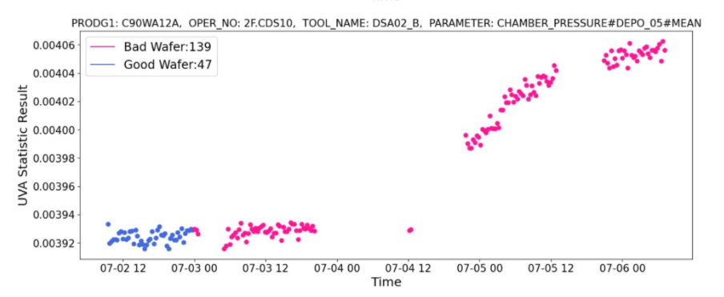
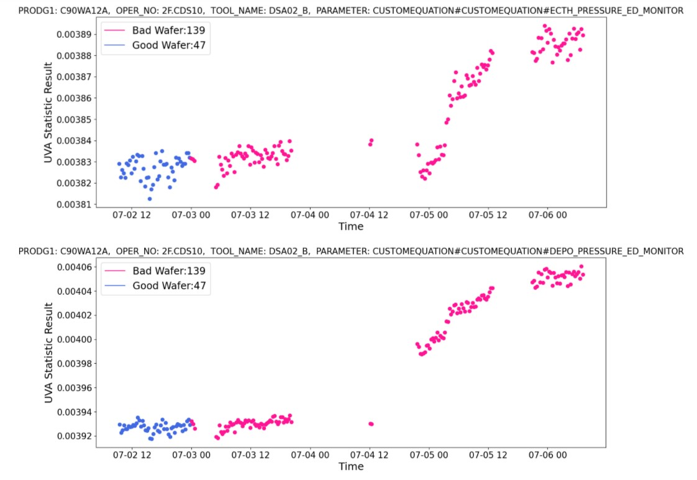
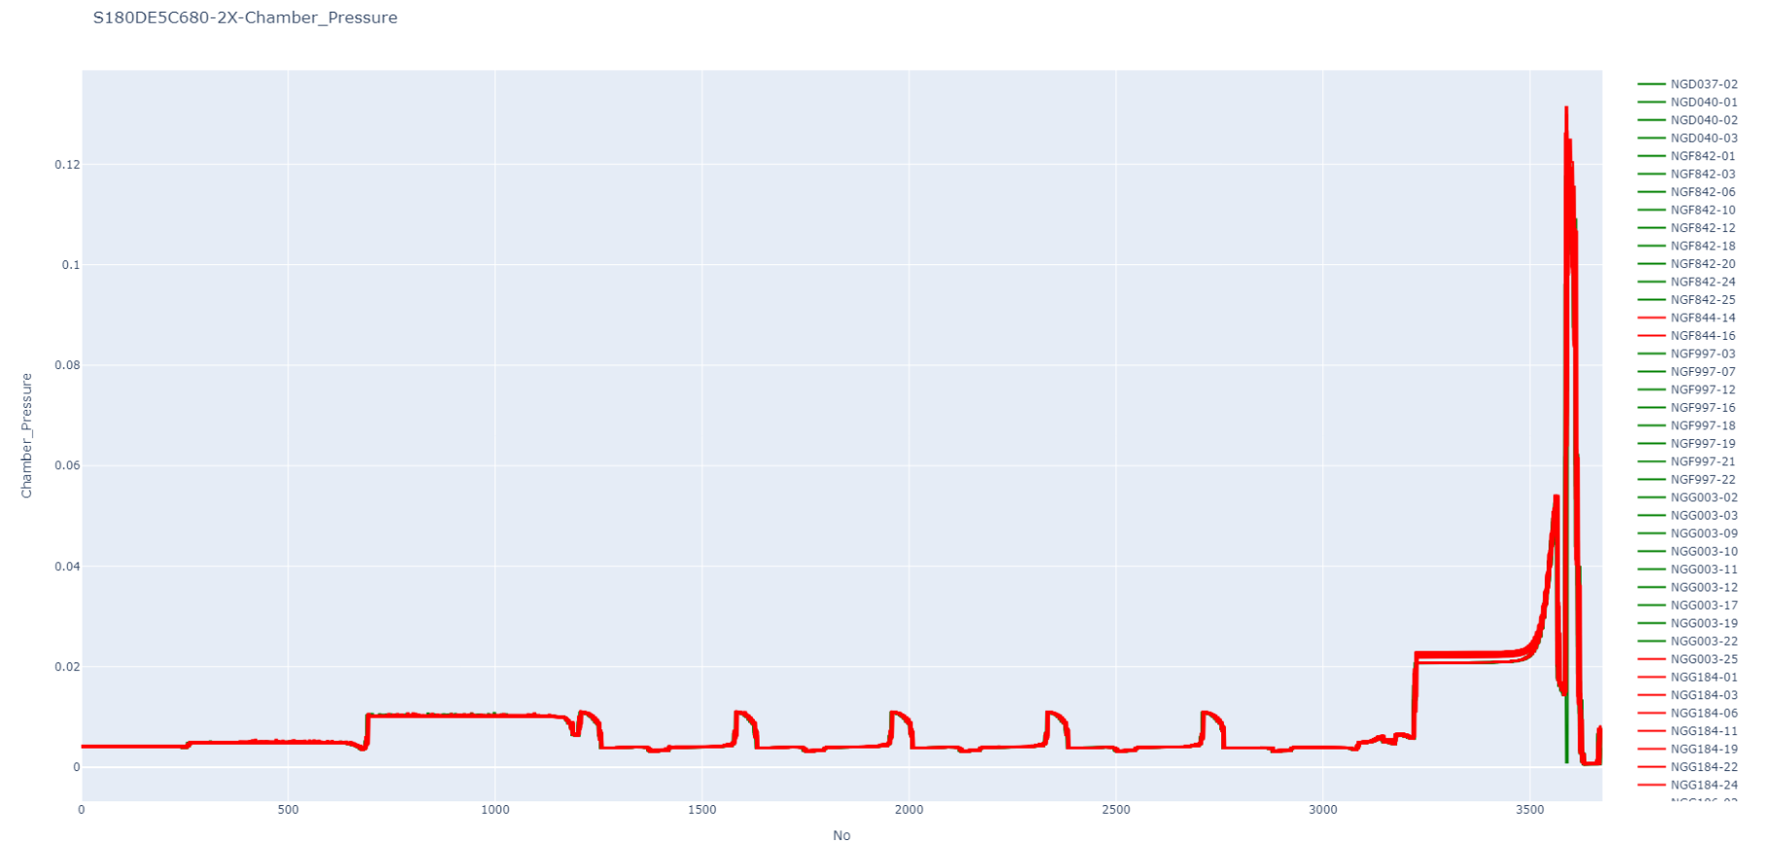
CUSTOMEQUATION#CUSTOMEQUATION
CHAMBER PRESSURE
发现存在部分明显的UVA MEAN偏离现象

Slide 8
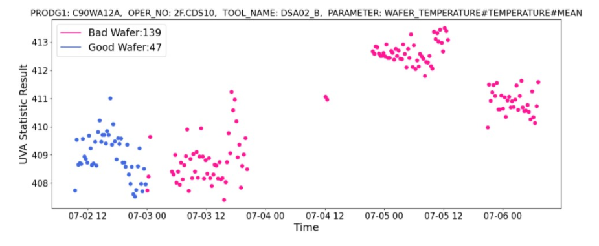
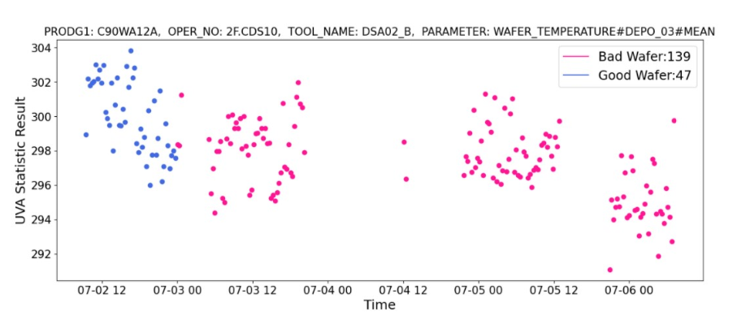
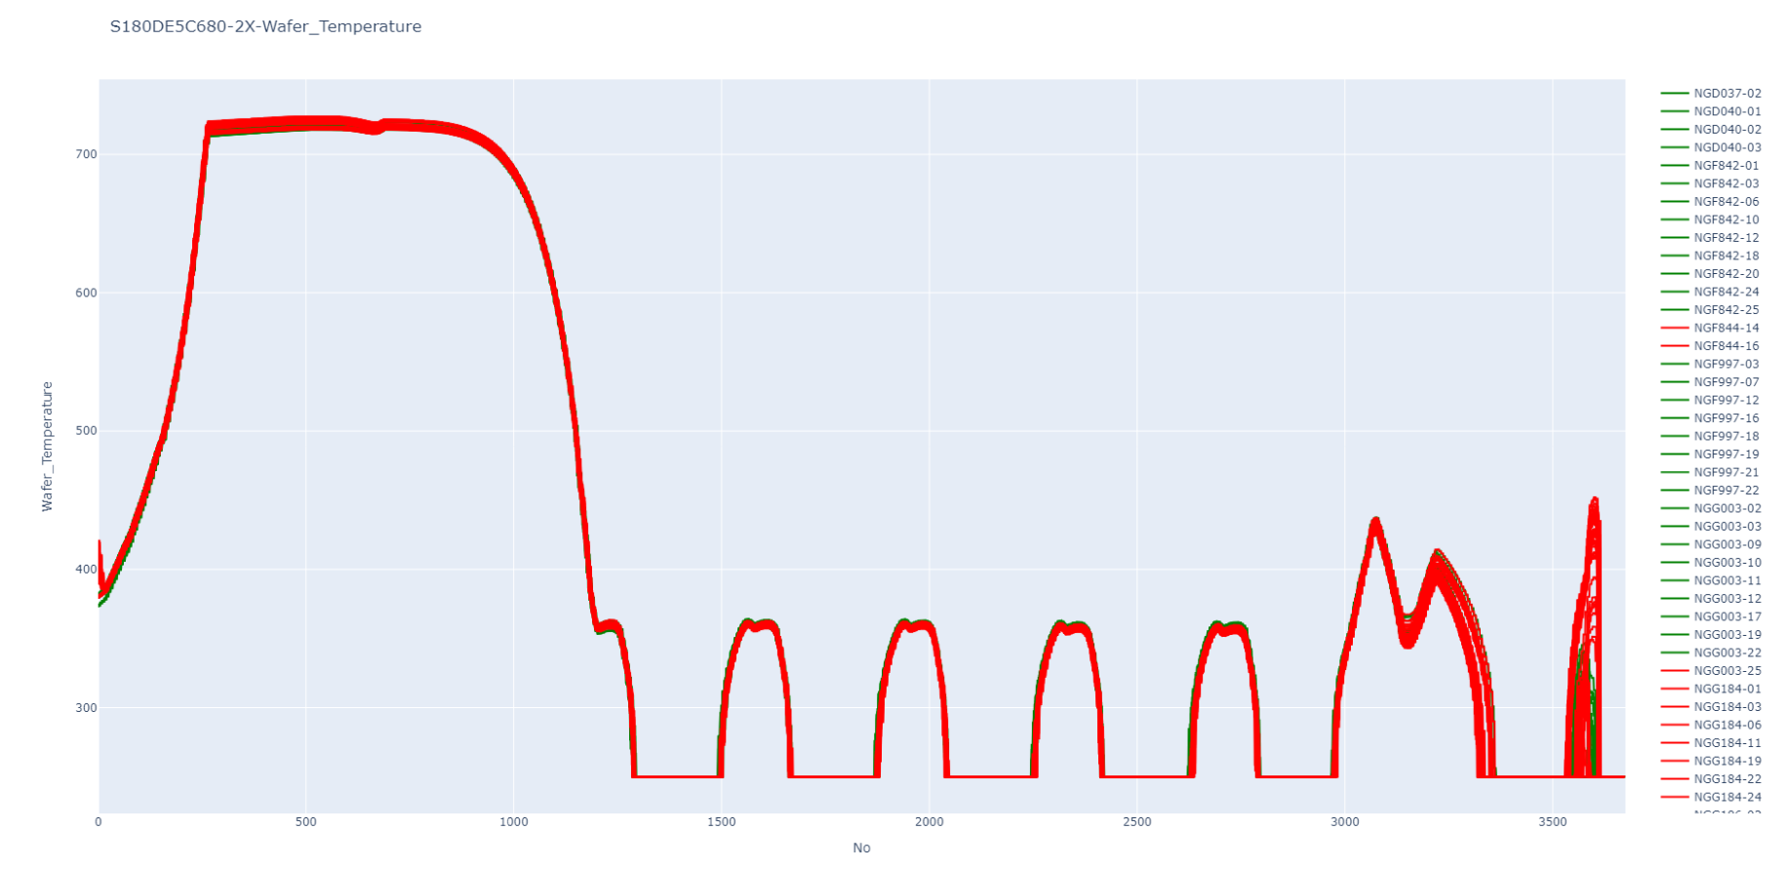
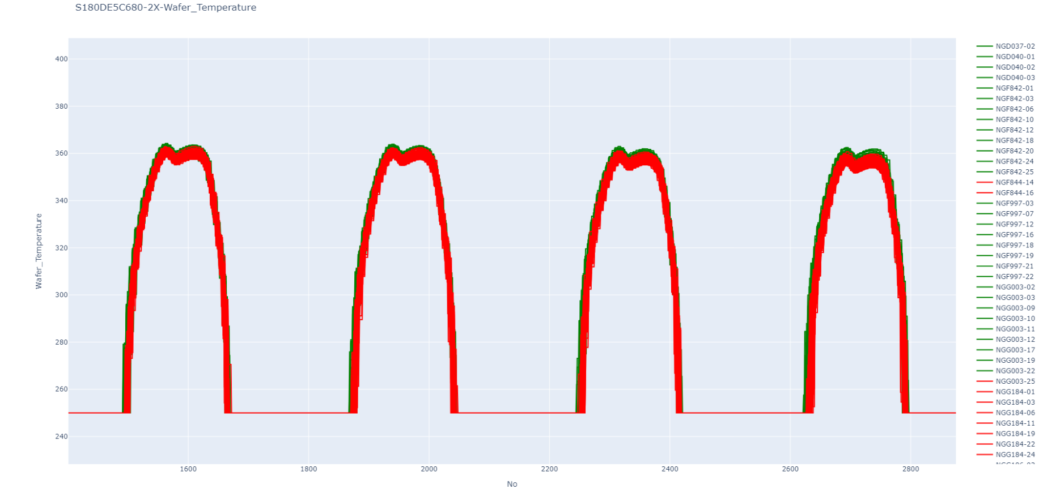
WAFER_TEMPERATURE

Slide 9
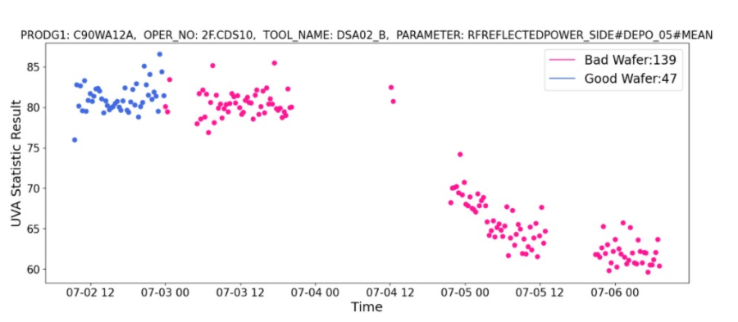
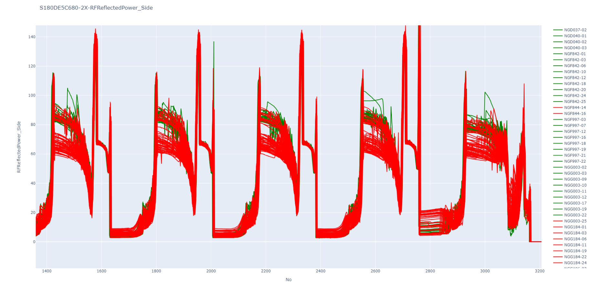
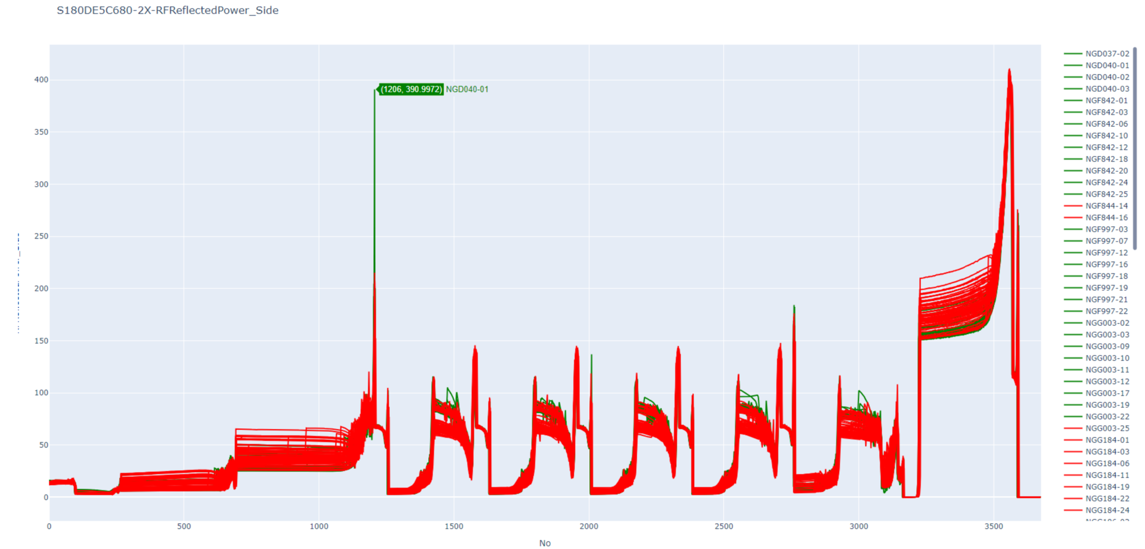
RFREFLECTEDPOWER
发现存在部分明显的UVA MEAN和RAW DATA偏离现象

